Slide 1
DBMS Queries
G. Varun Teja
227Z5A6603
CSE-AIML

Slide 2
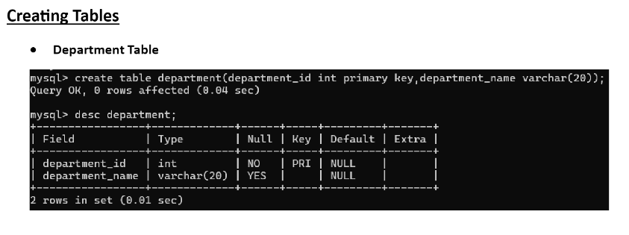
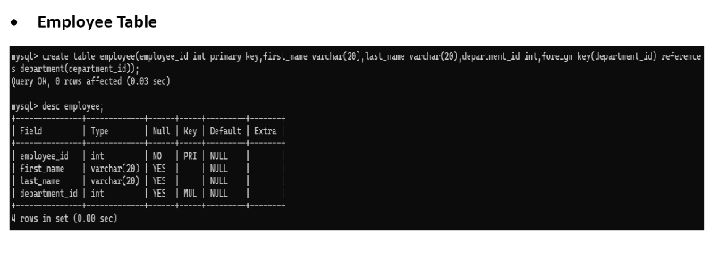

Slide 3
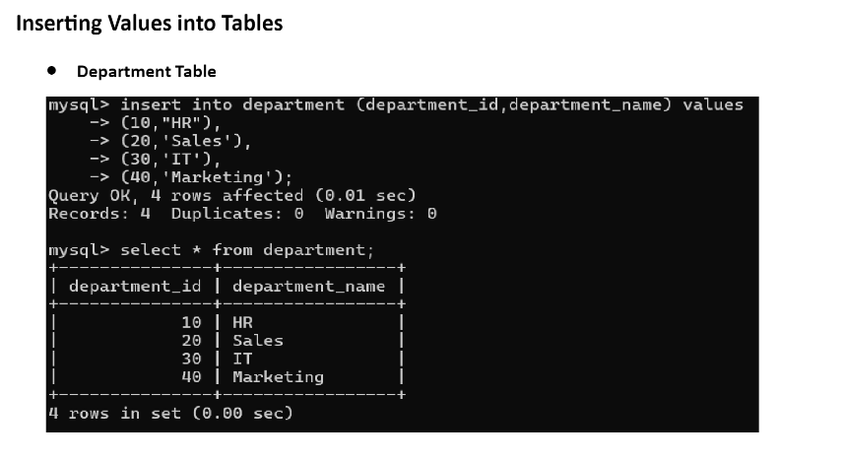

Slide 4
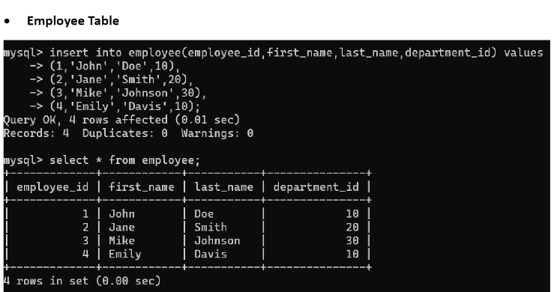

Slide 5
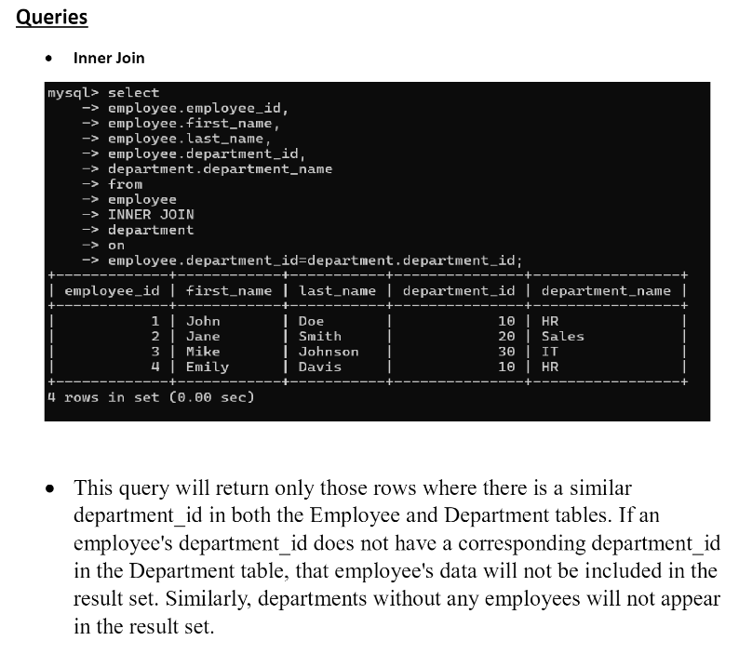

Slide 6
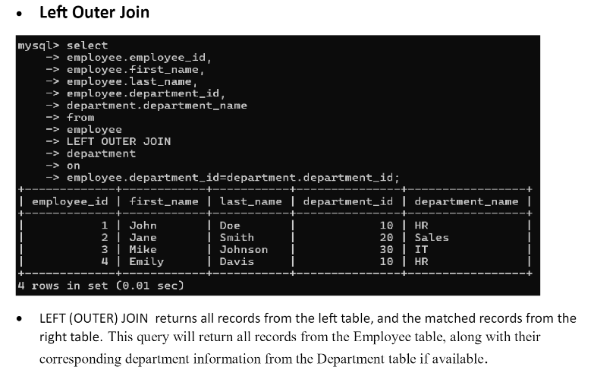

Slide 7
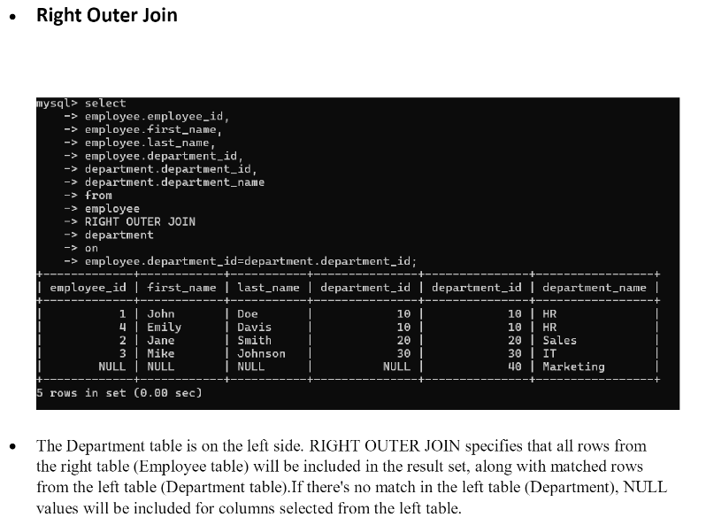

Slide 8
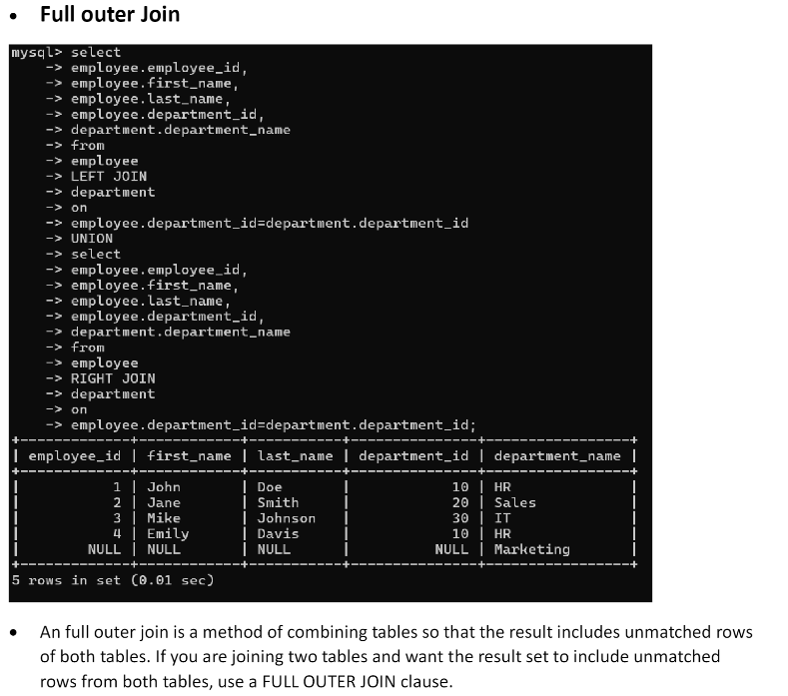

Slide 9
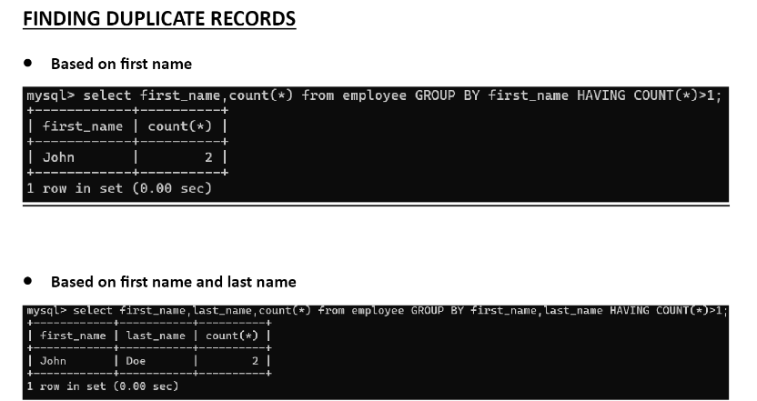

Slide 10
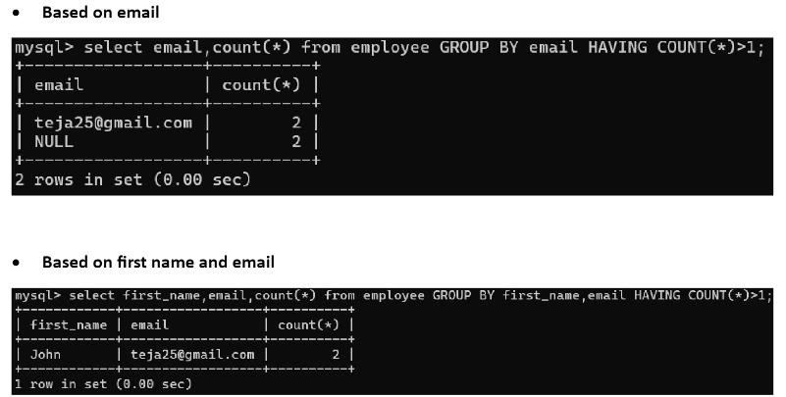

Slide 11
Convert bookstore.xml into json
<bookstore>
<book>
<title>Harry Potter</title>
<author>J.K. Rowling</author>
<price>29.99</price>
<available>true</available>
</book>
<book>
<title>The Hobbit</title>
<author>J.R.R. Tolkien</author>
<price>19.99</price>
<available>false</available>
</book>
</bookstore>

Slide 12
JSON
{
"bookstore": {
"book": [
{
"title": "Harry Potter",
"author": "J.K. Rowling",
"price": 29.99,
"available": true
},
{

Slide 13
Thank You

